Slide 1

Heap sort (non_recursive)
Habiba Mohamed Megahed
224231

Slide 2

In this Algoritm we fist build the heap using given elements
We build the heap by following this steps:
1. if a node is at index (i).
2. it is left child is at index (2*i).
3. it is right child is at index (2*i+1).
4. it is parent is at floor (i/2).

Slide 3
The second step We create a max heap to sort
Max heap provide a convenient way to efficiently maintain and retrieve the maximum element in a collection of elements
Max heap is a binary search tree such that every parent node is greater than both children.
Mini heap is a binary search tree such that every parent node is smaller than both children.

Slide 4

Once the heap is created we swap the root node with the last node and delete the last node from the heap and repeat this steps to sort

Slide 5
The Algorithm of non_recursive heap sort:
Def heapsort (arr):
n=len (arr)
For I in range (n//2-1, -1,-1)
heapify(arr, n, i)
For I in range (n-1, 0,-1)
arr[i], arr[0] = arr[0], arr[i]
heapify(arr, i, 0)
arr = [12,11,13,5,6,7]
heaosort(arr)
Print (“sorted array”, arr)
Def heapify(arr, n, i):
Largest = i
left_child = 2*i + 1
right_child = 2*i +2
If left_child < n and arr[left_child]> arr[largest]:
Largest = left_child
If right_child < n and arr[right_child]> arr[largest]:
Largest = right_child
If largest !=i:
arr[i], arr[largest] = arr[largest], arr[i]
Heapify(arr, n, largest)

Slide 6
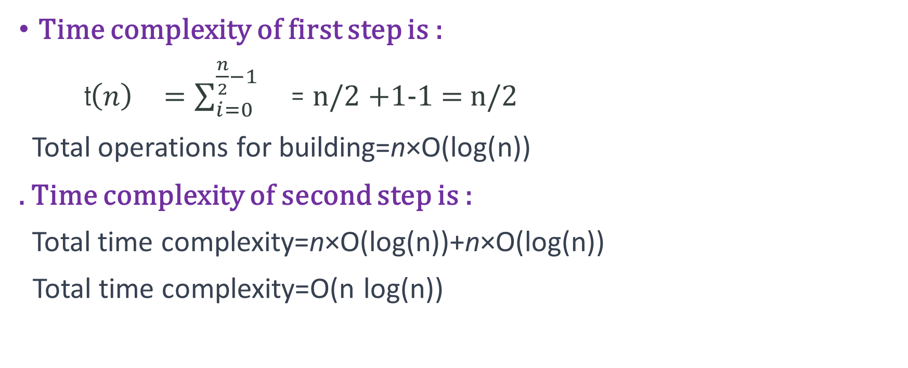
Time complexity
Time complexity of first step is :
t${\left(n\right)}^{}=\sum_{i=0}^{\frac{n}{2}−1}{}$= n/2 +1-1 = n/2
Total operations for building=n×O(log(n))
. Time complexity of second step is :
Total time complexity=n×O(log(n))+n×O(log(n))
Total time complexity=O(n log(n))

Slide 7

Thans

